Slide 1
TRAINING ON THE WASCAL EVENTS PLATFORM
Presentation
Dr Belko Abdoul Aziz DIALLO: Head of the Data Management Department(DMD)
Mme Mame Diarra DIOUF: Research Assistant at DMD
www.wascal.org

Slide 2
Introduction to WASCAL event based on indico
Categories
Event Management
Lectures
Meetings
Conferences
Privacy
Event Series
Document Generation
Room Booking
Searching and Booking
Viewing your Bookings
Blocking Rooms
OUTLINE
www.wascal.org

Slide 3
Introduction to WASCAL event based on indico
Running a conference or a large meeting can easily become a logistical nightmare for the organizers. Speakers often encounter technical difficulties such as laptop connectivity issues with projectors.
Additionally, relying on pen drives or hard drives to share slides can prove impractical.
Managing a conference requires coordination of multiple rooms, projectors, presentation PCs, and videoconference cameras necessitating numerous emails and consuming valuable time.
Each participant has a unique profile with extensive information.
While some resort to using Excel or other editors to compile information, this method is time-consuming and prone to errors, including the risk of losing the data altogether.
www.wascal.org

Slide 4
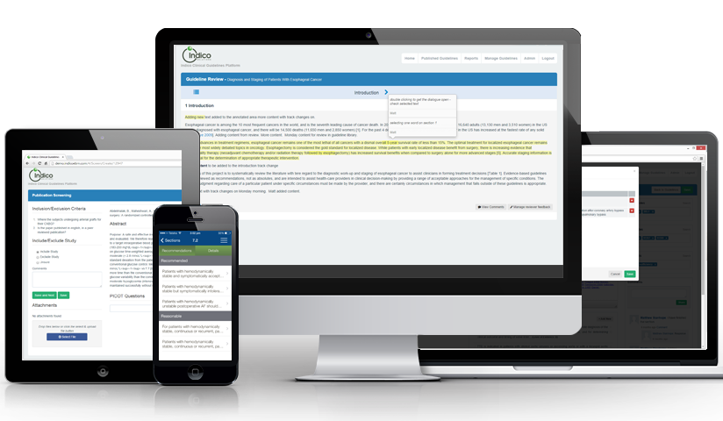
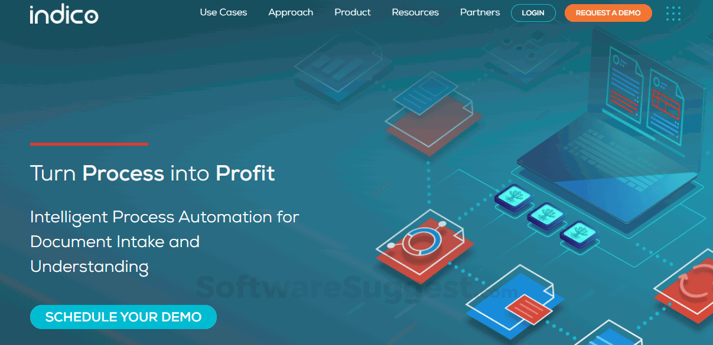
Introduction to WASCAL event based on indico
Indico is a web application that facilitates organizing events of all sizes, ranging from meetings and lectures to big conferences.
It is Open Source Software, developed at CERN, where the Web was born.
It offers a wide feature set, which includes reviewing workflows for scientific papers and their abstracts as well as a full-fledged room booking system.
www.wascal.org

Slide 5
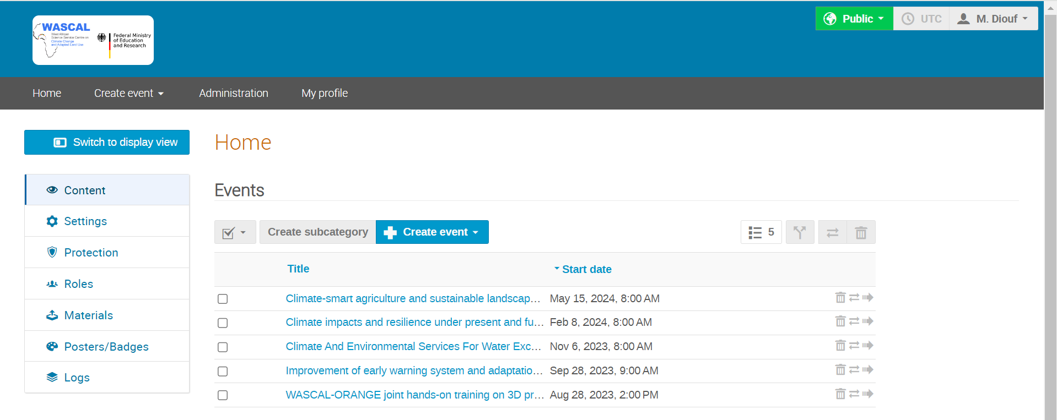
Categories
A Category is a means of grouping your events or other Categories together. In Indico, Home is the top-level category from where you start.
Inside a category you can:
add/delete events or other sub-categories,
set access rights to say who can access or modify,
re-allocate the sub-categories,
remove the sub-categories,
delete the current category and everything inside it,
and also insert a logo and a description in your own category.
You cannot have a category that contains both sub-categories and events.
www.wascal.org

Slide 6
Categories
Creating a Category
Having an Overview
Managing a Category
www.wascal.org

Slide 7
Event Management
Indico allows you to manage three basic types of events:
Lectures can be seen as a single presentation, with one or more speakers;
Meetings are generally composed of many presentations. They have a timetable and can last multiple days, although they most commonly happen on a single day. Contributions (talks) can be organized in sessions;
Conferences generally last multiple days and have the advantage over meetings of allowing multiple sessions to happen in parallel. They also offer flexible abstract and paper reviewing/editing workflows.
All of these meeting types offer a set of common features, such as:
Registration;
Management of participants;
Surveys;
Integration with collaborative tools;
Event reminders.
www.wascal.org

Slide 8
Lectures
A Lecture is an Indico event where you simply add a description or abstract, the speaker(s)'names and their material. It may re-occur over several days, still its definition is more homogeneous, hence simpler than an Indico Meeting. This short video shows all the basics of an Indico Lecture creation.
Creating a Lecture
Adding Material to a Lecture
www.wascal.org

Slide 9
Meetings
A Meeting is an Indico event in which you can include Minutes, in addition to all the other rich functionality that Indico events include. This short video shows the process of creating a meeting and adding all its paraphernalia.
Creating a Meeting
Making a Timetable
Adding minutes to a Meeting
Adding material to a Meeting
www.wascal.org

Slide 10
Conference
This is a complex event with many features, including Program definition and Call for Abstracts, Abstract submission, participants' Registration/Application to the event, e-payment facilities, and publication Review.
Defining the Program
Call for Abstracts
Submitting an Abstract
Reviewing Abstracts
www.wascal.org

Slide 11
Conference
Session management
Making a Timetable
Configuring the Registration Process
Registering at a Conference
www.wascal.org

Slide 12
Conference
Customizing the Conference Menu
Customizing the Conference Page Layout
Paper reviewing
Program Codes
People management
www.wascal.org

Slide 13
Privacy
Indico includes a number of privacy features to help you manage your participants' registration data and to keep the participants informed about how their personal data is handled.
Managing event privacy settings
Data controller
Privacy notice
Participant visibility
Data retention period
www.wascal.org

Slide 14
Event Series
Indico makes it possible to link multiple events together in an Event series. Events in a series can display links to other events in the series on their main page.
Creating an event series
Editing a series
Cloning events in a series
Exporting a series to a calendar
www.wascal.org

Slide 15
Document Generation
Indico includes a module for generating documents, such as receipts and certificates, from templates that can be defined in the event or category. This feature is especially useful for conference organizers and administrators who need to provide attendees with customized documents quickly and efficiently.
Creating a Template
Generating a Document
www.wascal.org

Slide 16
Room Booking
This chapter describes Indico's Room Booking Module. Indico users can book a room for their conference, meeting or lecture. Room managers can monitor and moderate all bookings. Indico administrators can create rooms and manage their data. This section is a tutorial and will go through the features of the room booking module. It will show you how to:
search for available rooms and book or pre-book them (as a regular user)
accept or reject pre-bookings (as a room moderator)
block a series of rooms for a given period (as a room owner)
www.wascal.org

Slide 17
Searching and Booking
Let’s now look at how to search for an available room based on more specific criteria. For this, click on List of Rooms in the horizontal menu.
www.wascal.org

Slide 18
Viewing your Bookings
You can view the bookings or pre-bookings that you made by going under the My bookings section of the Room Booking side menu.
Your Bookings
All the bookings
www.wascal.org

Slide 19
Blocking Rooms
Room Blockings prevent regular users from booking certain rooms while allowing a restricted list of users to do so. This feature can be used for special events which require a given room at 100% and need some kind of "room delegation" mechanism.
www.wascal.org

